Slide 1


caArray User Community Meeting
caArray User Community Meeting
2.2.0 Feature Overview and Review of MAGE-TAB Update and Export Specification
2.4.0 Update and geWorkbench Overview
Call in: 877-416-5524
Participant Passcode: 2627056
Centra: http://ncicb.centra.com
Meeting ID: ICR_meeting
November 5, 2008
Call in: 877-416-5524
Participant Passcode: 2627056
Centra: http://ncicb.centra.com
Meeting ID: ICR_meeting
June 6, 2010

Slide 2
Agenda
Update on caArray 2.4.0
  New data parsers
geWorkbench Overview
Support / Knowledge Center

Slide 3
caArray 2.4.0
Timeline: expected release in 1st week of August
Scope: New Data Parsers
  Agilent:
    GEML/xml array designs (aCGH, gene expression and miRNA)
    Raw TXT data files (aCGH, gene expression and miRNA)
  Nimblegen – Community Code Contribution:
    NDF array designs
    Pair Report (raw and normalized) data files
  Illumina:
    BGX/TXT array designs
    Gene expression: Sample Probe Profile TXT files with unique Probe_Id
    Genotyping: Processed matrix TXT files with unique IlmnID values
  Affymetrix:
    AGCC/Command Console formats for CDF, CEL and CHP files.
    CNCHP files with copy number and LOH data.
  Copy number data in MAGE-TAB Data Matrix format

Slide 4
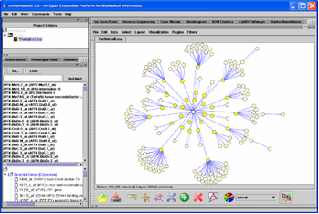
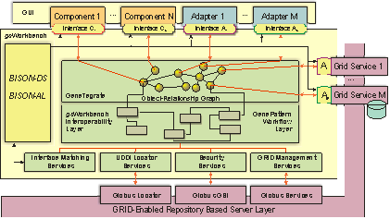
geWorkbench
Integrated genomics analysis application
Support for gene expression data, sequences, pathways, structure.
70+ visualization and analysis modules (MAGNet focus; 3rd party modules).
Access to local/remote data sources and analytical services (caBIG technologies)
Integration with biological annotation sources.
Development platform
Open source, Java-based.
Component architecture, facilitating customization.

Slide 5
The Case for Integration
Institutional
Database
Analysis
Tool(s)
source
data
analysis
results
annotations
annotations
annotations
KEGG
GO
NCBI
Data Transformation
New Interface
Computational Resources

Slide 6
Component-based Architecture
Large collection of components
Data parsers: Affy MAS/GCOS (txt and CEL), Genepix, RMA, FASTA, caArray, PDB, GEO Soft, MAGE-TAB matrix
Data Management: Project folders, marker/sequence/array groups.
Visualization: Dendrograms, color mosaics, scatter plots, SOM clusters, BLAST results, dot matrices, Cytoscape.
Analyses: Hierarchical clustering, t-test, ARACNE, ANOVA, SVM, MINDy, MarkUs.
3rd Party components: Cytoscape, GoMiner, MatrixReduce, GenePattern.

Slide 7
New Features in geWorkbench 2.0
New Components
Skyline: a high-throughput comparative homology modeling pipeline
Skybase: a database for homology models built by Skyline for all NESG PSI2 protein structures
Pudge: protein structure prediction
Major New Features
Java 6 support
Look and Feel
Data Format Support: MAGE-TAB matrix, GEO Soft
Data Filtering
caBIO upgrade
Component Configuration Manager

Slide 8
Example Workflow in geWorkbench
DATA: 100 microarrays from normal and malignant human B-cells
(data from Reverse engineering of regulatory networks in human B cells,
Basso et al., Nat Genet. 2005, 37(4))
Data
loading
Data
preprocessing
Differential
expression
Clustering
Annotation
Integration
Gene Ontology
Analysis
Network
reconstruction
Sequence
Retrieval
TF binding site
Discovery
Sequence
Analysis
Protein Structure
Modeling
Structure-based
Annotation

Slide 9
Should You Give geWorkbench a Try?
Pros
  Allows you to look at the data in different ways
  Contains standard data analysis methods
  Contains cutting-edge data analysis methods
  Is integrated with data management tools
  Is integrated with biological annotation information
  Is supported by the MATKC
  Is free
Cons
  You have to spend some time to learn
  It might not contain the method that you want to use
  It has bugs
  You think that you have no say on where it is going

Slide 10
What’s New on caArray Support
New Knowledgebase Articles
  caarray057 I deployed caArray in Eclipse but got exception when I tested the caArray. Why?
  caarray058 Is there any guideline for Applying OS patching and Java updates on servers running caArray?
  Caarray059 Where to download caArray 2.3.1 GUI Installer?
  Caarray050 Introduction to caArray: Browse & Search caArray Repository
  Caarray060 How to export experiment annotation and data files into MAGE-TAB and GEO SOFT formats?
  caarray056 How to Import Affy .TXT file into caArray
Community Code Contribution Update
  caArray Standalone Client (CSC) by UAMS

Slide 11
Avenues for Feedback
Molecular Analysis Tools Knowledge Center Forum
Gforge Community Change Request tracker:
  http://gforge.nci.nih.gov/tracker/?atid=1339&group_id=305&func=browse
This meeting
Next Meeting:
Wednesday, June 7, 2:00 PM ET

